Slide 1

Linsane Brewery Market Analysis
Because your beer should be as insane as you!!
Manisha Pednekar, Jason Lin, and Jason Lingle
Notes:
To change the image on this slide, select the picture and delete it. Then click the Pictures icon in the placeholder to insert your own image.

Slide 2
Introduction
This is a market analysis for the startup company Linsane Breweries.
The company is interested in understanding the current geographic market for beer, and also the different styles by different breweries across the nation including District of Columbia.
The main factors analyzed are alcohol by volume (ABV), international bitterness unit (IBU), and geography.
The following report will show the ABV and IBU by state, and also high level plots of the relationship between ABV and IBU.

Slide 3
Data Cleansing Assumptions
Removal of duplicate beers.
Removal of special characters from beer names and breweries
Renamed incomplete beer names
Renamed incomplete brewery names
Limited data on IBU

Slide 4
Breweries Per State
The number of breweries in each state (including Washington D.C.) ranges from 1 to 47. Where there are many states, such as DC, South Dakota, and West Virginia with one brewery, Colorado has 47 breweries. Below is the table of breweries by state.

Slide 5
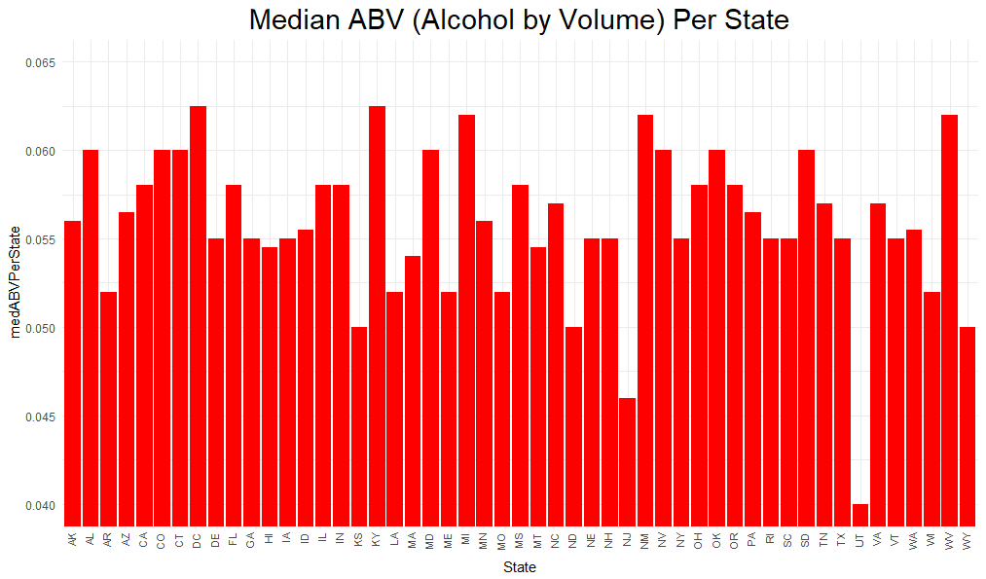
Median ABV Per State
When looking at the graphs for median ABV by state, we see that Utah comparatively has the lowest alcohol content at around 0.04 or 4%. DC has the highest alcohol content at 0.0625 or 6.25%.

Slide 6
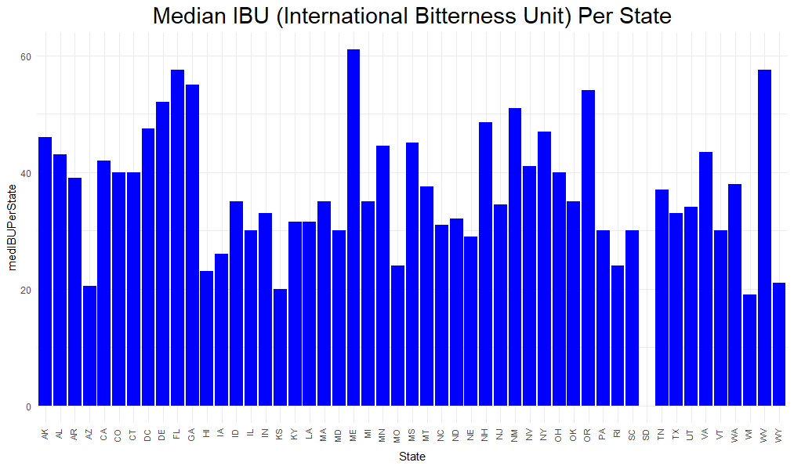
Median IBU Per State
When looking at the graphs for IBU, South Dakota did not record any IBU values so there is no information on this state. The lowest IBU content is 17 for the state Wisconsin and the highest IBU is 61 for the state Maine. We have to keep in mind the range of IBU is from 0 to 100, where 100 is the most bitter.

Slide 7
Maximum ABV and IBU
The analysis is done based on median values calculated by State. This is more of central tendency measurement, so it would not be influenced by outliers. When looking at the graphs for median ABV by state, we see that DC has the highest alcohol content at 0.0625 or 6.25%. When looking at the graphs for IBU, the highest IBU is 61 for the state Maine. We have to keep in mind the range of IBU is from 0 to 100,
Note: Maximum Values Highlighted

Slide 8
Other Information
When looking at all ABV for beers, we calculated the 5 number summary.
The minimum is 0.001 or 0.01% and the maximum is 0.128 or 12.8%.
Giving a range of 12.7%.For 25% of the data, the range of ABV is between 0.01% to 5%.
For 50% of the data, the range of ABV is 0.01% to 5.6%.
For 75% of the data, the range of ABV is between 0.01% to 6.8%.
The average ABV content is 5.98%.

Slide 9
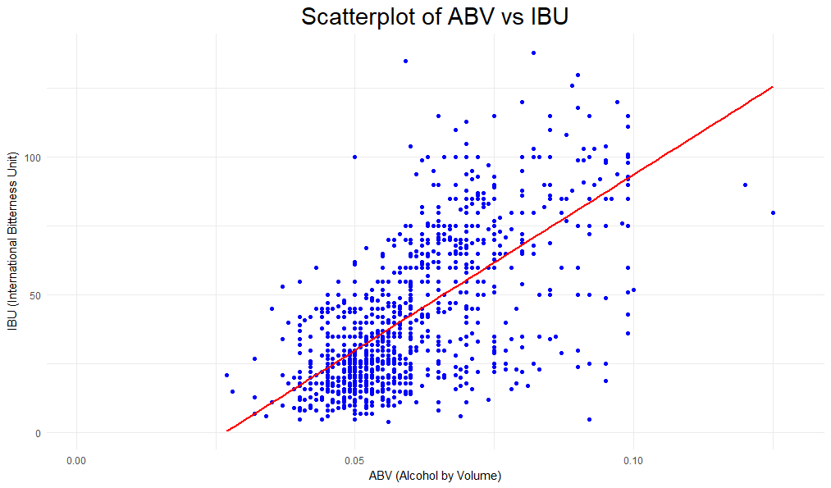
Relationship Between IBU and ABV
When looking at the scatterplot of ABV vs. IBU, we see that the points are clustered more in a linear upward trend.
This may signify a postive linear correlation between ABV annd IBU. A Pearson correlation test is done to see if there is a statistical significant relationship.
The pvalue for the test is <0.0001. Therefore, we may be able to say that about 43% of the variation is IBU is explained by ABV where the correlation between the two variable is 0.66.

Slide 10
Conclusion
After analyzing the data, we see that there is high number of breweries that are located in Colorado and California area.
The reason behind this we do not know, however it is possible the water quality maybe better there or a high concentration of people that love beer in that area.
When looking at the overall alcohol content, the range is between 5.6% to 6.8% being near to the middle 50% of beers analyzed. Also the mean and median are close (5.9% and 5.6% respectively).
The measure for IBU for this data may not be reliable just because it is proprietary. From the beers that do provide this data, we see that the range of bitterness is between 17 and 61. When looking at the scatterplot and the statistical analysis for linear correlation, we some evidence that IBU and ABV having a positive linear-relationship.
The bitterness of beer may come from the amount of alcohol or visa versa.

Slide 11
Next Steps
We can perform further analysis on the most popular beers by region
For further analysis, we can look further into styles and the profile within each (ABV and IBU)
Additional analysis should be on where to locate breweries to maximize profit.

